Slide 1



Welcome to the Club!
CW RMM/COmmand Admin program kick-off

Slide 2
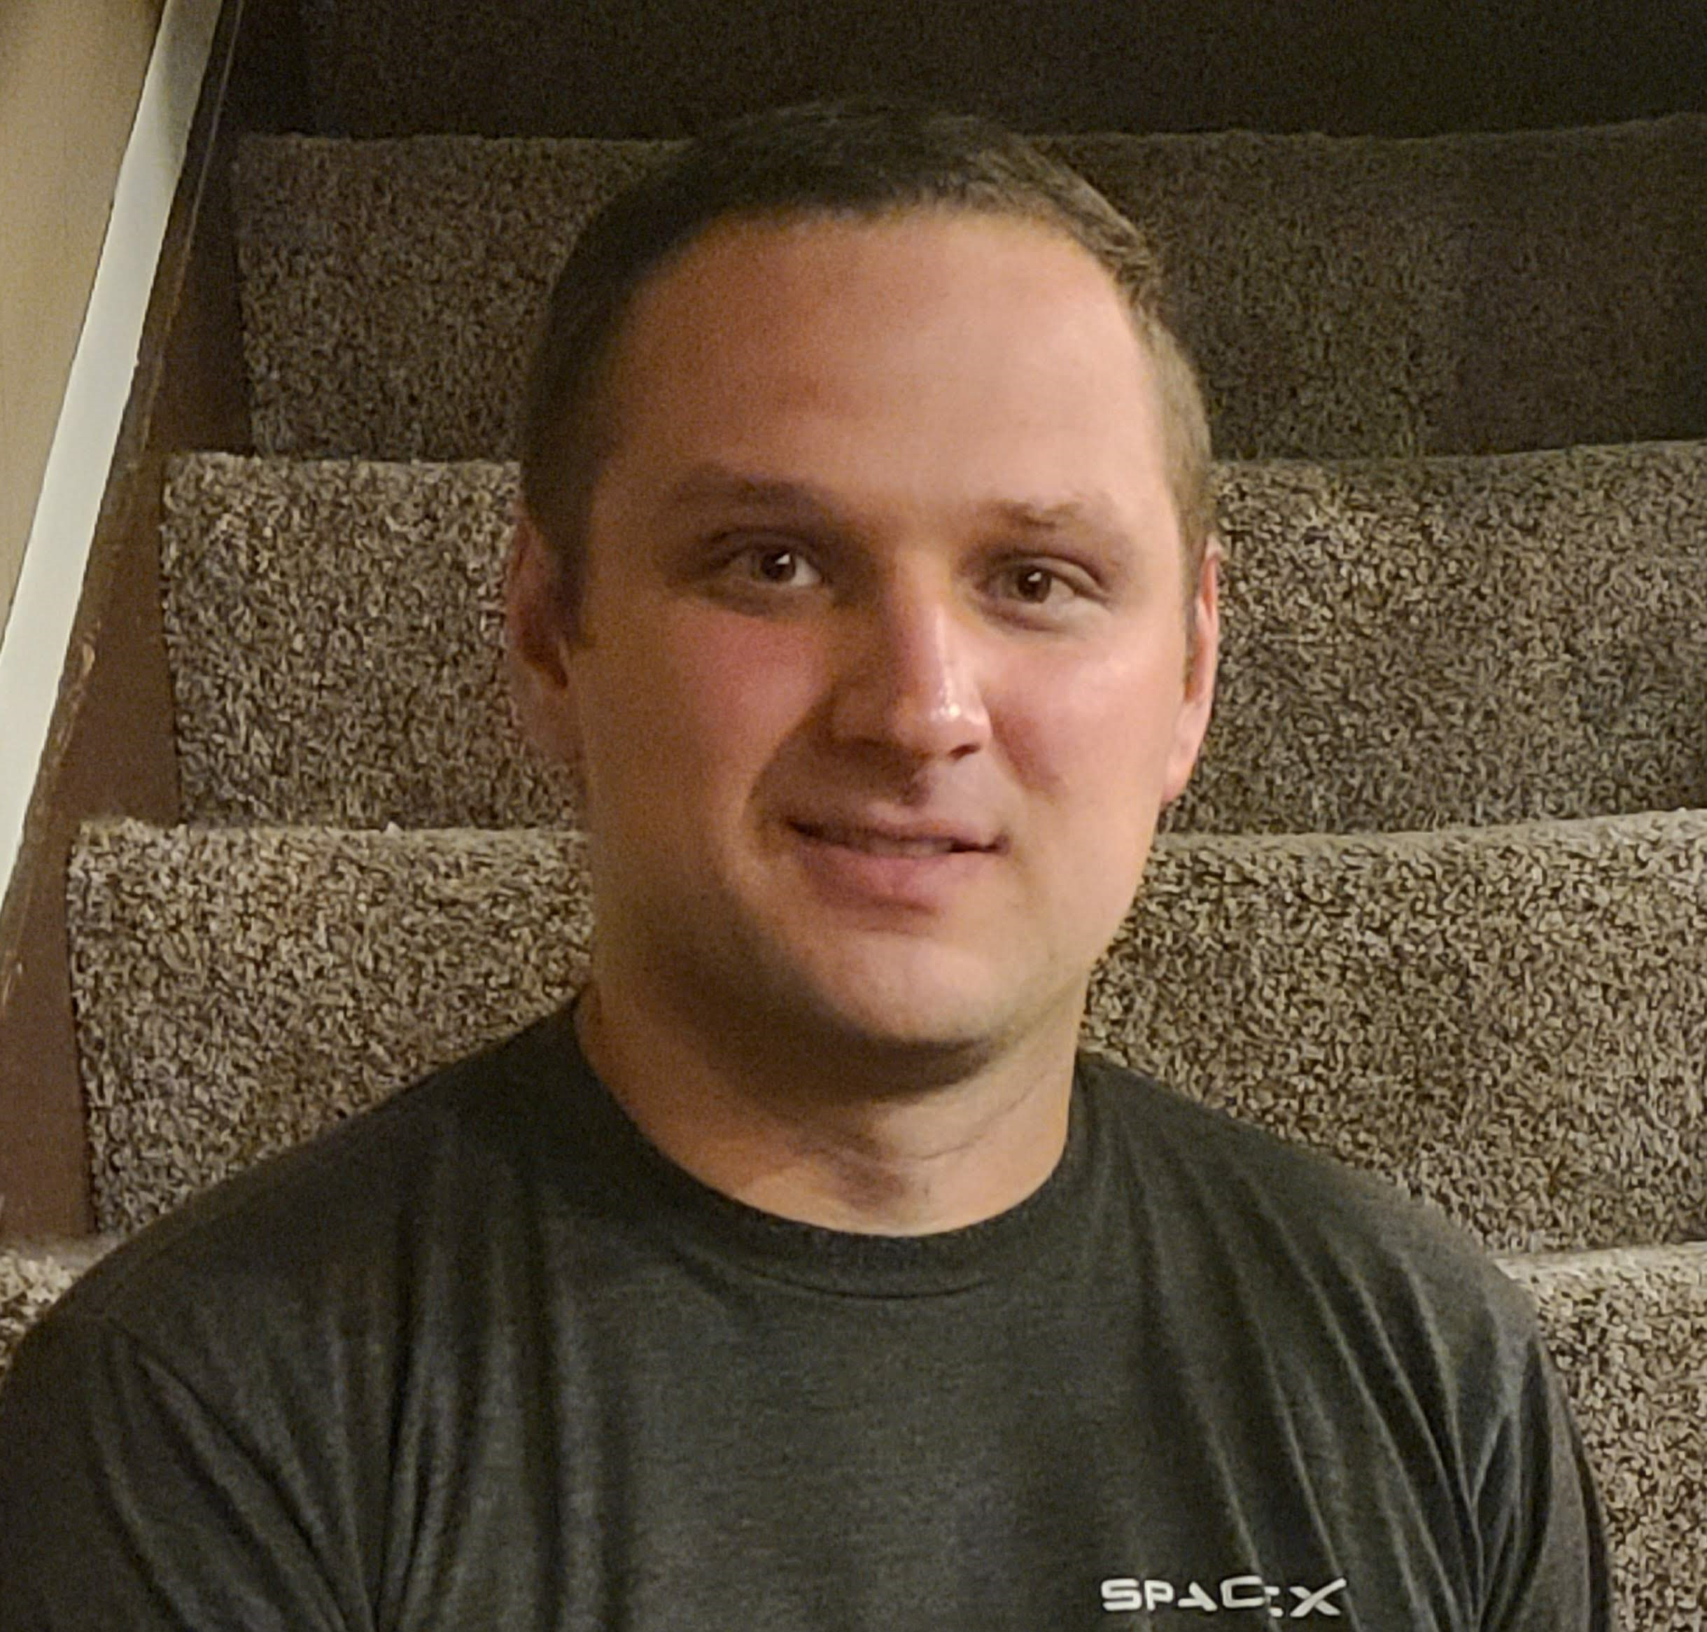





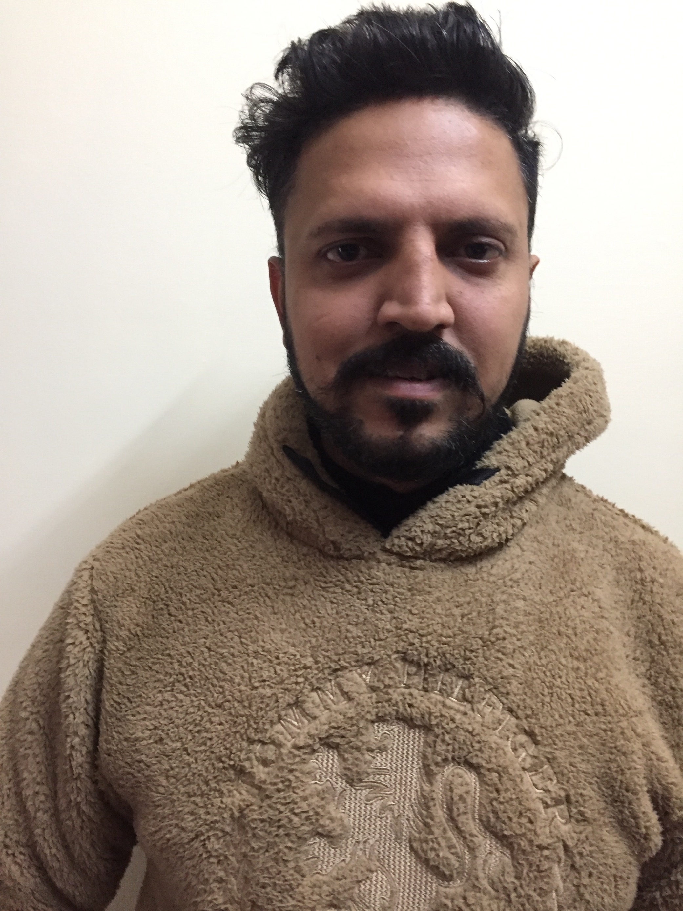

WHO WE ARE AND WHAT WE DO
CONSULTING AND SUPPORT TEAM
Stephen Nix
Automate Engineer & Dev Ops
Alex Ramsbey
MSP Consultant
Ryan Mueller
MSP Consultant
Mir Shahid
Systems Engineer
Amit Pandey
Systems Engineer
Rajni Singh
Systems Engineer
No Photo
Chase Murphy
Service Delivery Manager
Chris Mitchell
MSP Consultant
Kamaldeep Kaur
Systems Engineer
Ram Kishor
Systems Engineer
Sawar Arora
Systems Engineer
Raghav Nayyar
Systems Engineer

Slide 3
ONBOARDING SCHEDULE
TYPICALLY 4-6 WEEKS
Stage 1
Package/Policy & branding review
Scheduled scripts review
Integrations review
Patch Configuration review
User Accounts Review
BrightGauge Patching dashboard creation
Week 1 Review call
Stage 2
Complete Action Items Defined in Week 1 Review Call
Antivirus Review
Sites Review
Environment Cleanup
Machine Groups
Agents Not Checking in report and cleanup
PSA and Ticket Review
Noise analysis
PSA Integration
CW Control Review
Week 2 Review call
Stage 3
Complete Action Items Defined in Week 2 Review Call
Intellimon monitoring review
Custom monitor review
Offline server monitoring
Custom ProVal Solutions load-in
Week 3 Review Call
Stage 4
Finish all action items from prior weeks
Schedule Staff Training
Schedule Monthly Admin Meeting
Final Review Call
Notes:
Make sure that you review what each section covers:
Stage 1: Covers the Automate Application
Stage 2: Covers Old data and service plan/Ignite Setup
Stage 3: Covers Monitors and Automation review
Stage 4: At this point we start wrapping up the project and moving into your monthly Administration.

Slide 4
ENGAGING PROVAL
Do you like talking to us on the phone?
Email support@provaltech.com
Ask for a callback, leave your direct line and the next available consultant will give you a call.
What if you just aren’t sure?
Just email support@provaltech.com …. We’ll figure it out for you.
There’s only one thing we ask
Try not to email our consultant’s directly, they live and breath tickets. ☺
Have a billing issue or questions?
Email billing@provaltech.com
Need to submit a support request?
Email support@provaltech.com
What about big scary issues?
Email support@provaltech.com
Be sure to include the work “Urgent” or “Emergency” in the subject line.

Slide 5
CREDENTIALING
All credentials are stored in our secure ITGlue Instance.
ITGlue is locked down to only ProVal IP addresses
ProVal locks ALL accounts under 2FA immediately after logging in.
ProVal will change the password after logging in and setting up 2FA
ConnectWise RMM/Command
Application
Username (PRONOC)
Email: pronoc@yourdomain.com
Password
Role: Super Admin
IP Restriction Management
ConnectWise Control
Application
FQDN
Username (PRONOC)
Email address (pronoc@yourdomain.com)
Password
Role: Administrator
BrightGauge
FQDN
Username (PRONOC)
Email address (pronoc@yourdomain.com)
Password
Role: Admin

Slide 6
QUESTIONS?
Ask us anything!

